Slide 1


WEBRTC architecture used by google duo and its Security & Performance
Date: 2022-05-10
Group ID : SE3030-WE-24
Student ID | Name with initials
IT19018560 | Widanapathirana W.P.V.K
IT20115920 | Warnakulasuriya I.S.G
IT20115852 | Diwyanjalee K.V.S
IT20097042 | Perera J.S
System : Google duo
Architecture : WEBRTC Architecture
Key Qualities: Security & Performance

Slide 2
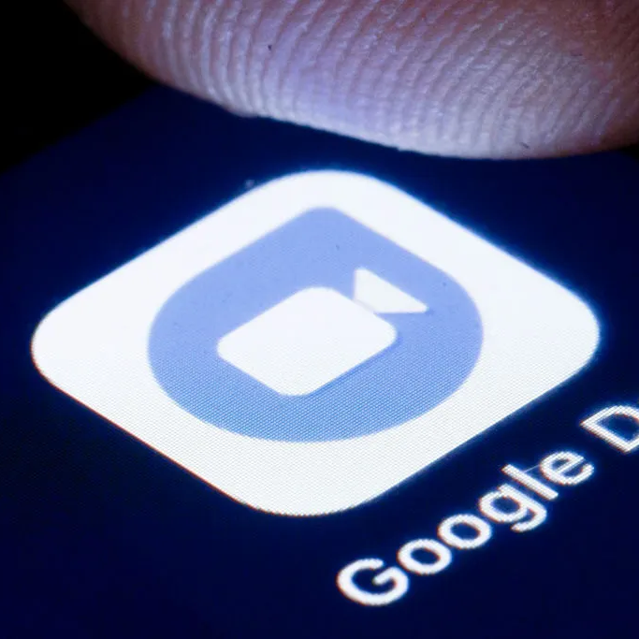
IT19018560
Content
Abstract
Introduction
Analysis
Compare
Conclusion
References
Questions

Slide 3

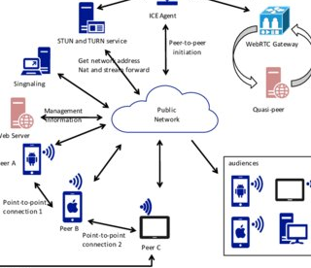
ABSTRACT
IT19018560
The main purpose of the presentation is to explain the WEBRTC architecture used by duo and the security and performance features of the duo app.
According to this presentation mainly we discuss What is WEBRTC Architecture, How to use WEBRTC Architecture to google duo, why duo was built around the WEBRTC Architecture style, How to use security for duo & how to use performance for google duo.

Slide 4

INTRODUCTION
IT19018560
1
Google Duo is Google’s new video calling app.
2
3
Nowadays, like other social media apps, this social media app is gaining popularity among the people, which means that this google duo app is very high in terms of performance as well.
It works on both Android devices and iOS devices.
The Duo is a great way to communicate with friends and family who live far away.
The WEBRTC architecture was used to create the google duo app.
Also, a survey conducted among the social media apps currently in use has revealed that the google duo app is ranked second in terms of security.

Slide 5

WHAT IS WEBRTC ARCHITECTURE
ANALYSIS
IT19018560
1
2
3
WEBRTC is a new technology, as well as an ECMAScript API, that allows browsers to communicate directly in real time.
This technology enables real-time media communication between current browsers, such as speech, video, and other data streams
WEBRTC is being developed and standardized by the World Wide Web Consortium (W3C) and the Internet Engineering Task Force (IETF), in collaboration with industry heavyweights such as Google and Apple. It is open source and free to use, and its purpose is ,
“To enable rich, high-quality RTC applications to be developed for the browser, mobile platforms, and IoT devices, and allow them all to communicate via a common set of protocols. The WebRTC initiative is a project supported by Google, Mozilla and Opera, amongst others.”

Slide 6
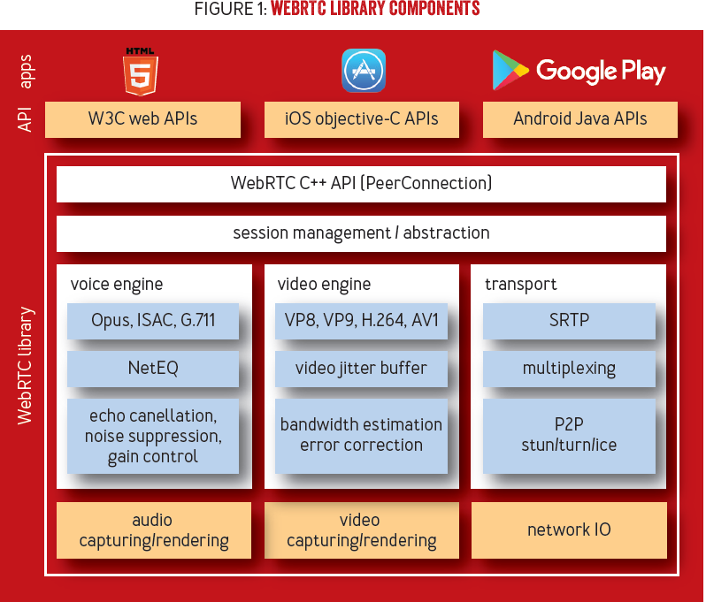

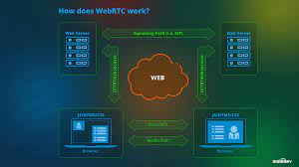
HOW TO USE WEBRTC ARCHITECTURE TO GOOGLE DUO
IT19018560
Google Duo video calls are in 720p HD video. It is optimized for low-bandwidth mobile networks through WebRTC and uses QUIC over UDP.
Google Duo use of WebRTC has led to peer-to-peer connectivity and end-to-end encryption, making it secure and reliable.
There are three main parts to real-time communication: signaling, media, and data.
All these processes are handled by three groups of WEBRTC APIs: getUserMedia, Peer Connection, Data Channel

Slide 7
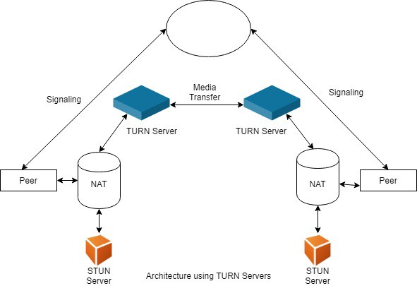
WHY DUO WAS BUILT AROUND THE WEBRTC ARCHITECTURE STYLE?
IT19018560
According to mobile application specialists, it is a free and open project supported by Google, Mozilla and Opera and others.
It provides browsers, mobile apps with Real-Time Communications (RTC) capabilities through simple APIs.
It allows you to develop rich and high quality RTC applications for IoT devices which can communicate with RTC applications for mobile and web via a common set of protocols.
If one or both parties has some sort of video camera, the call can also involve video.
Furthermore, the JavaScript APIs involved in enabling this peer-to-peer communication are simple enough that you can create a WebRTC client with just five or six lines of JavaScript and HTML.

Slide 8


HOW SECURITY IS GOOGLE DUO
IT20115852
WEBRTC uses the protocol called Datagram Transport Layer Security (DTLS) to transfer data in real time.
Other than that it uses Secure Real-Time Protocol for video and audio data encryption.
Hence, eavesdropping, scanning an IP connection by unauthorized people, and information falsification are excluded in the encrypted connection.

Slide 9

IT20115852
PERFORMANCE OF GOOGLE DUO
Be part of bedtime
Tuck them in with their favorite stories over one-to-one video calls with the highest quality, so you don't miss a precious moment.
Capture special moments
Take a photo of your video call to capture any moment, and share it automatically with everyone on the call.
More fun with the entire family
Google Duo’s new Family mode lets you doodle on video calls for everyone to see and surprise loved ones with fun masks and effects. Family mode also helps avoid accidental hang-ups and mutes by hiding those buttons while you play together
Make video calls more fun
From putting on a pair of virtual heart glasses to channeling your inner dinosaur, new AR effects let you express yourself. These fun new effects change based on your facial expressions and move with you around the screen.
Get the group together
Keep the fun times rolling with your weekly game nights over group calling. Available for 32 friends at a time and works on Android phones, iPhones, iPads and tablets. You can also join a group call with just a link.

Slide 10
IT20115852
User Interface
When launching Google Duo, you are welcomed by the front camera view. Below, you get the contacts list on Duo, and by tapping on them, you get the options for making voice calls, video calls, or recording a video message.
Send a little love their way
Brighten up someone’s day by sending a note, voice or video message with fun effects. Let them know you’re thinking of them, even when they’re far away or can’t pick up.
Easy Accessibility
Google Duo are easy to navigate and prove a great performance overall. They use a user’s contacts to make the video calls rather than an email or other type of user account, making it incredibly easy to make a call if the recipient’s phone number is saved into your device. .
Capture special moments
Take a photo of your video call to capture any moment, and share it automatically with everyone on the call.
Keep calls private with end-to-end encryption
Whether it's one-to-one calls, group calls or video messages, your conversations on Duo will always stay private with end-to-end encryption.

Slide 11

WHY THE SECURITY & PERFORMANCE ARE KEY TO THE DUO SYSTEM SUCCESS?
IT20097042
The reason for focusing on the security and performance side of the duo app is because this is an app, security and performance can be cited as two things that people often consider when using an app
So the success of an app depends on the number of people who use it.
The app will be very successful if used in large quantities.
Therefore, people use the duo app mainly based on the existing features of security and performance.
Therefore, it is clear that the duo app has been able to succeed through both these security and performance features.

Slide 12

IT20097042
HOW THE WEBRTC ARCHITECTURE STYLE AND SECURITY, PERFORMANCE HAVE IMPROVED OR WORSENED OVERALL QUALITY OF THE DUO SYSTEM UNDER CONSIDERATION?
Considering the security and performance in a duo app created using the WEBRTC architecture, one can conclude that this architecture and these attributes have made it possible to create a duo app as a successful application.
There is nothing wrong with these attributes and WEBRTC architecture in the currently built duo app.
Because the duo app is used for communication, the WEBRTC architecture can be pointed out as the most suitable architecture to use for it.
Therefore, it is clear that the WEBRTC architecture used here has been a great help in making it a very successful application.
It is also important to pay attention to the security and performance in the app when creating any application, Therefore, the security of this app is very high, and it is possible to use this app in a way that does not interfere with the personalization of individuals.
Also, this app has a very high level of performance, so people can easily make video calling and communication through this app.
Therefore, these two attributes have been considered very well in the creation of this duo app and it has been a great contribution to the success of this app.

Slide 13
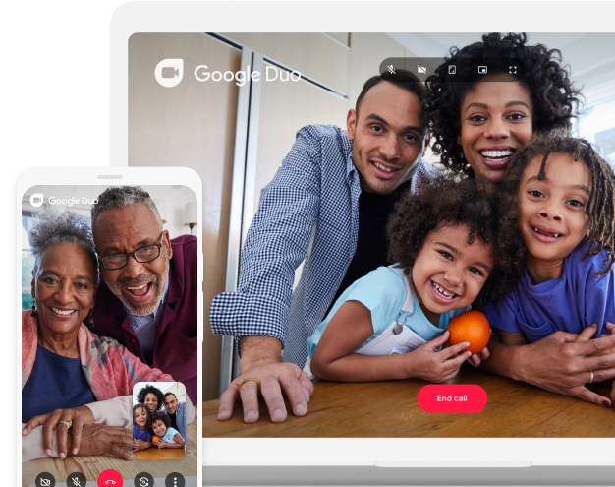
IT20097042
WHAT HAS BEEN DONE TO IMPROVE THE SECURITY, PERFORMANCE OF THE DUO SYSTEM
it is only available on Android and iOS devices, so users who want to use it on their computer or Windows phone must find an alternative. Therefore, improvements in the way that this can be used in computers as well Will be important
it does not have many features compared to other video calling apps. For example, it does not allow users to share their screens or record video calls. Such performance should be enhanced in this app

Slide 14
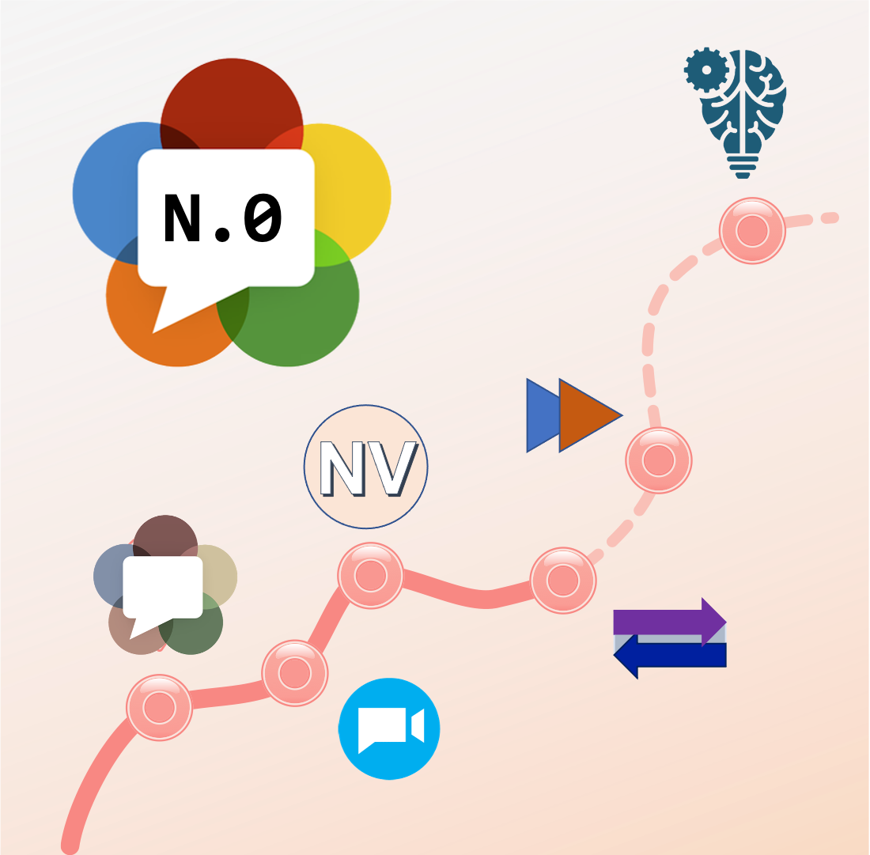
WHAT OTHER QUALITY ATTRIBUTES WERE AFFECTED? AND HOW SO?
IT20115920
Reliability
When you make a call on Duo, the audio and video is encrypted end-to-end and not stored on Google servers. Messages sent on Duo are stored encrypted on Google servers.
The reliability attribute is an attribute that goes with the security attribute so the security in the duo app is very high and the reliability is also very high. Therefore, reliability can be pointed out as another important quality attribute in the duo app.
Accessibility
creating an easy-to-use experience for everybody. At Duo, our goal is to build usable security for everyone and that means having empathy for all of our diverse end users. We have focused primarily on the end user experience; the parts of Duo’s software that are seen by the most people. The Duo Prompt has seen the most improvement as we work to make it WCAG 2.0 AA-level accessible. The Duo Mobile application has also undergone accessibility audits and improvements.
Notes:
Let's see what other quality attributes ware affected in Google DUO.
First one, Reliability.
When we make a call in Google Duo the audio and video data that transfers in google servers are always end-to-end encrypted. Messages saved on their servers are also encrypted. That means reliability and security of user's data on Google DUO is very high. It is very important attribute that should have in every platforms.
Next one Accessibility,
At DUO, their goal is to build usable security for everyone. That means having empathy for all of end users. UI/UX is the best part of the application that seen by many users. The Google DUO application has developed following Web Content Accessibility Guidelines (WCAG) 2.0 mid range level. The mobile application of DUO is also has undergone accessibility audits and improvements.

Slide 15

COMPARE
Messaging and video calling apps are famous these days. One of the more popular ones is Google Duo, which lets you stay in contact with friends and family from anywhere. But how does it compare with rivals like WhatsApp, Viber, Skype, and Zoom?
IT20115920
The main thing you should know is that Google Duo doesn’t support instant messaging. It only supports audio and video calls. This is the biggest difference between Google Duo and other popular rival apps. WhatsApp, Signal, Skype, Messenger, and Viber all allow you to send messages in addition to making calls.
According to many recent surveys, the google duo app is ranked third.
The first place went to the zoom and Skype apps.
Therefore, one of the disadvantages of comparing it with other video audio apps is that duo have lost the first and second places in the rankings due to the above.
But that doesn't mean this is a bad app.
It ranks third only in terms of features available in the zoom and Skype apps.
The google duo app has many good aspects and is inferior in comparison to other apps due to the inability to type and send messages.
Notes:
Let's compare Google DUO with other video calling apps.
Messaging and video calling apps are famous these days. According to many surveys, Google DUO gets the third place. One of the main disadvantages of comparing DUO with other video calling platforms is DUO doesn't support chat feature. But most of other applications support this feature. It doesn't mean that DUO is a bad platform.
The google DUO has good features as we discussed so far.

Slide 16

CONCLUSION
IT20115920
In our opinion, If you are interested to build your own mobile app like Google Duo with video calling features then you have to implement WebRTC protocol. Moreover, you can easily find the third-party libraries and technologies in WebRTC, designed to process media data transfer (audio and video content, in this context).
Notes:
In my point if you are interested to build a new video calling application like Google DUO it's better to implement this app using WebRTC protocol, designed to process media data transfer

Slide 17

REFERENCES
IT20115920
webrtc architecture used by google duo
1. https://bloggeek.me/googles-private-webrtc-roadmap-2020/
2. https://www.fiercewireless.com/wireless/google-takes-facetime-webrtc-based-duo
3.https://webrtc.github.io/webrtc-org/architecture/
Security
1.https://support.google.com/duo/answer/10477159?hl=en
2.https://guidesmania.com/is-google-duo-safe-for-private-video-calling/
3.https://securitygladiators.com/security/software/video-calling/
4. https://www.linkedin.com/pulse/how-build-your-own-mobile-app-using-google-duo-paul-cook/
Performance
1.https://duo.google.com/about/
2.https://henrilechatnoir.com/whatsapp-vs-google-duo-the-best-app-for-video-calling/10848/
Notes:
these are the references that we used..

Slide 18

ANY QUESTIONS

Slide 19

THANK YOU!
Notes:
That the end of our presentation.
lastly ...thank you for your time and we'd really appreciate it.

